Slide 1


Protecting AWS Resources: Security Groups & Network ACLs
A Dual-Layered Approach to Cloud Security
TEAM - 22

Slide 2
Security Groups: Instance-Level Virtual Firewalls
Virtual Firewall
Stateful Operation
Acts as a virtual firewall for EC2 instances and other AWS resources like RDS and Load Balancers.
Automatically allows return traffic for permitted inbound connections, simplifying rule management.
Allow Rules Only
Granular Control
Defaults to denying all inbound traffic; only explicitly allowed traffic is permitted. Outbound is generally allowed.
Control traffic based on protocol, port, source/destination IP (CIDR), or by referencing other Security Groups.

Slide 3
Security Group Best Practices
Implement these guidelines to strengthen your AWS security posture.
Principle of Least Privilege
1
Grant only the minimum necessary access. For example, allow SSH from specific trusted IPs, not from 0.0.0.0/0.
Categorize by Role
2
Create distinct Security Groups for different application tiers (e.g., Web, Application, Database) to enforce clear separation of concerns.
Reference Other Security Groups
3
For internal communication between resources, specify the source or destination as another Security Group for dynamic and resilient environments.
Descriptive Naming & Tags
4
Use clear, consistent naming conventions (e.g., sg-web-public-80) and apply relevant tags for easy identification and effective resource management.

Slide 4

Network ACLs: Subnet-Level Network Filters
Subnet-Level Control: Optional, stateless firewalls applied at the subnet level, affecting all instances within that subnet.
Stateless Operation: Requires explicit allow rules for both inbound and outbound traffic, including return traffic. No automatic allowance.
Allow and Deny Rules: Supports both "Allow" and "Deny" rules, providing the ability to explicitly block specific IP addresses or traffic types.
Numbered Rule Processing: Rules are evaluated in numerical order (lowest to highest). The first matching rule is applied, and no further rules are evaluated for that traffic.
Implicit Deny: Any traffic not matched by an explicit rule in a custom Network ACL is implicitly denied, enhancing security.

Slide 5
Security Group Best Practices: Continued
1
2
3
Regular Audits & Reviews
Monitor & Alert
Automate Management
Periodically review and refine Security Group rules to maintain a strong security posture, remove obsolete access, and adapt to evolving requirements. Automate where possible.
Integrate Security Group logs with AWS CloudWatch and CloudTrail. Set up alerts for suspicious activity, unauthorized changes, or broad access rules.
Leverage infrastructure-as-code tools like AWS CloudFormation or Terraform to manage Security Groups, ensuring consistency and version control.

Slide 6
Security Groups vs. Network ACLs: A Comparison
Feature
Security Groups (SGs)
Network ACLs (NACLs)
Scope
Instance-level (ENI)
Subnet-level
Statefulness
Stateful (return traffic automatically allowed)
Stateless (return traffic must be explicitly allowed)
Rule Types
Allow rules only
Allow and Deny rules
Order of Evaluation
All rules evaluated
Numbered order (lowest to highest), first match applied

Slide 7
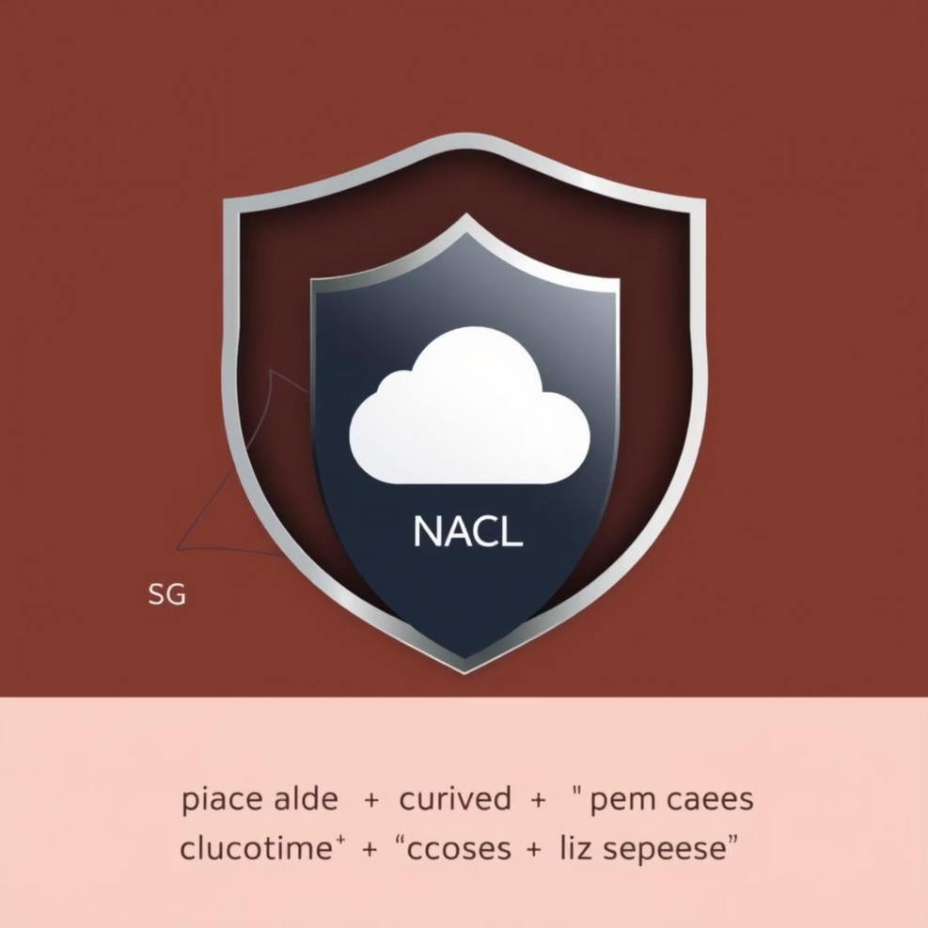
Complementary Security Layers
Security Groups and Network ACLs are not mutually exclusive; they are complementary components of a robust AWS security strategy. Think of them as layers of an onion.
Security Groups: Provide fine-grained, instance-specific control.
Network ACLs: Offer coarse-grained, subnet-wide filtering and are crucial for explicit deny rules against known malicious traffic.
Recommendation: Utilize both. Security Groups should be your primary defense for instances, with NACLs acting as a broader, secondary defense layer at the subnet boundary.

Slide 8




Key Takeaways & Next Steps
Layered Defense
Strategic Configuration
Security Groups and Network ACLs provide essential, complementary layers of network security for your AWS resources.
Understand their distinct roles (instance vs. subnet, stateful vs. stateless) to configure them effectively.
Continuous Review
Further Learning
Regularly audit and refine your rules to maintain optimal security posture and adapt to evolving threats.
Explore AWS documentation on VPC security, AWS Firewall Manager, and other advanced network security services.

